Slide 1
Los Olivos Community Services District Wastewater Treatment Plant Siting Study

Slide 2
Los Olivos CSD Mission
Provide a funding mechanism
Build and operate facilities required to collect and treat wastewater, and reclaim the purified water effluent
Improve groundwater quality in unincorporated Los Olivos

Slide 3
Los Olivos CSD Project Components
Develop requirements for wastewater collection and treatment
Implement a local groundwater monitoring program
Obtain funding for design, construction, and operation
Design and build collection system and treatment plant
Operate wastewater treatment plant and collection system

Slide 4
Purpose of Third Party Siting Matrix
A look with “fresh eyes” to ensure that LOCSD had not overlooked anything during earlier siting studies
Background for the study: “Although the District has already spent considerable time considering siting options in an ongoing effort to not overlook best opportunities, with a number of optional sites having been identified, this additional effort was commissioned to assure suitable optional sites were not overlooked.”
Looked at all parcels within a 1-mile radius

Slide 5
Expander Third Party Siting Matrix - Added Category Weights
UPC Categories | LOCSD Weight | Basis for Weights / Comments
Lot only, no structures? | 0.2 | Not a key parameter
Available Right-of-Way? | 0.2 | Not a key parameter
Size Within Ideal Range? | 2.0 | Want ample offsets, so no upper limit
Open Land, Could Subdivide? | 0.5 | A more complicated option
Elevation Compared to District? | 2.0 | Minimize number of lift stations
Distance from District? | 0.5 | Collection system costs
Close to Alamo Pintado Creek? | 0.3 | Backup option for effluent disposal
Environmental Challenges? | 0.5 | Would impact costs, amount unknown
Pipeline Crosses Creek? | 0.5 | Would impact costs slightly
Good Access? | 1.0 | Needed for operation/maintenance
Site Physical Constraints? | 1.0 | Would impact costs
Site Availability? | 3.0 | Need to purchase or long-term lease
(There was not enough information for percolation to be a consideration)

Slide 6
Design Siting Decision Matrix (top 5 sites)
APN | Owner Offered to District | Lot Size | Elevation Below Phase 1 | Elevation Below Phase 2 | Access | Physical Constraints | Could be Sub-Divided | Commercial Zone Proximity | Environmental Challenges | Pipe Needs Bridge | Residential Proximity | Creek Proximity | Lot Only? | Excess Right of Way | TOTAL
 | 3 | 2 | 2 | 2 | 1 | 1 | 0.5 | 0.5 | 0.5 | 0.5 | 0.5 | 0.3 | 0.2 | 0.2 | Weight
135230028 | 10 | 10 | 10 | 10 | 10 | 10 | 10 | 5 | 10 | 0 | 5 | 5 | 10 | 0 | 128.5
135110024 | 5 | 10 | 10 | 7 | 5 | 10 | 10 | 5 | 10 | 10 | 0 | 5 | 0 | 0 | 103
135110023 | 5 | 10 | 10 | 7 | 5 | 10 | 10 | 5 | 10 | 0 | 0 | 5 | 10 | 0 | 100
135110025 | 10 | 10 | 5 | 7 | 0 | 0 | 10 | 5 | 0 | 10 | 0 | 5 | 0 | 0 | 88
135180040 | 0 | 10 | 8 | 6 | 10 | 10 | 10 | 5 | 0 | 10 | 5 | 10 | 10 | 0 | 88
The top score is significantly higher than the other scores

Slide 7
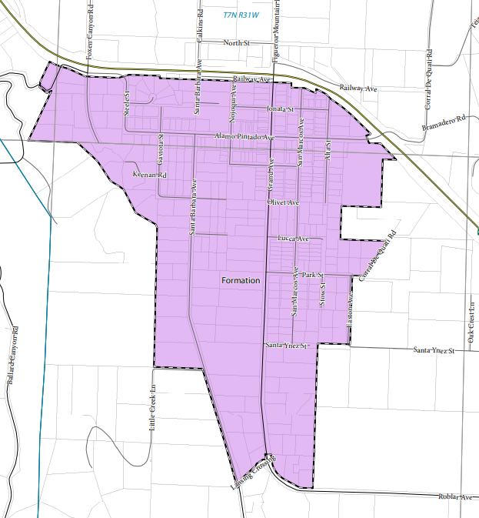
District-Wide Design Based on Identified Preferred Sites
Elevation decreases as you head south
Alternative site
APN: 135110024
Preferred site
APN: 135230028

Slide 8
Government Code Allows Plant Siting Outside District
District Counsel has confirmed that the District has the legal authority to acquire and use property outside the boundaries of the District, as stated in Government Code section 61060, subsections (d) and (e). Further, the District can apply to LAFCO to annex any property acquired outside of the District for inclusion in the District, a process made simpler with the consent of the owners of the affect property or properties—which coincides with one of the above criteria. More information on LAFCO actions available to the District are available here: http://www.sblafco.org/application_forms.sbc

Slide 9
LOCSD is Focused on Being a Good Neighbor
Eliminate “Special Problems Area” designation for Los Olivos
Implement cost-effective wastewater treatment
Implement groundwater quality monitoring to capture the impact of Los Olivos wastewater treatment
Design and construct a wastewater treatment plant that has the appearance of a barn or agricultural building:
Enclosed operations mitigate noise and odor issues
Reasonable setbacks from property lines
Carefully planned vegetation to enhance the appearance

Slide 10
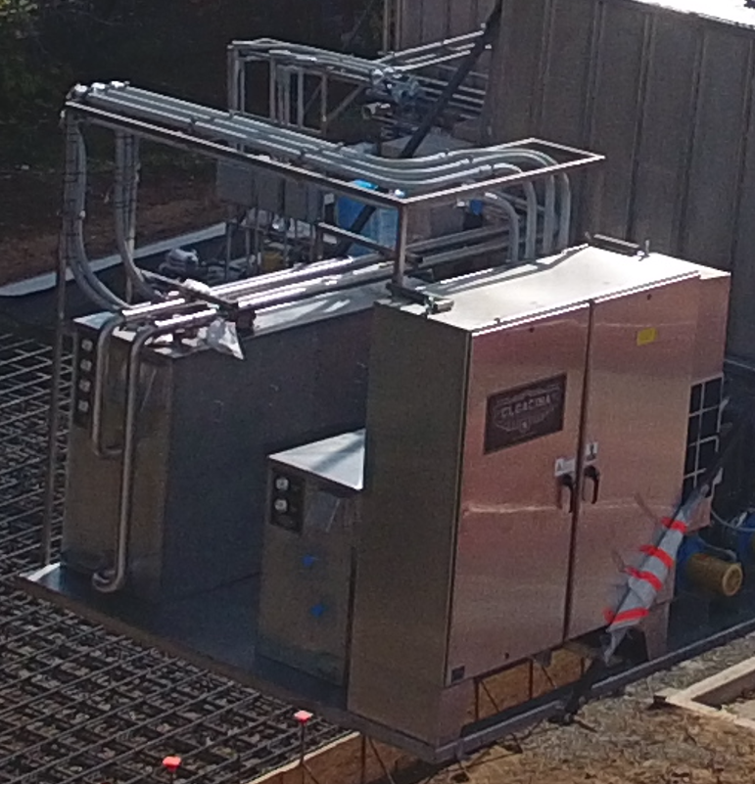
Facility Mitigations
Screening – block wall or chainlink fence with slats and vines
Odor attenuation: enclose anoxic and screen sections and scrub air space with an odor scrubbing process – remainder of plant is highly aerobic and does not generate odor
Sound attenuation using stainless steel enclosures (60 decibels [normal conversation] at a distance of 5 feet)

Slide 11
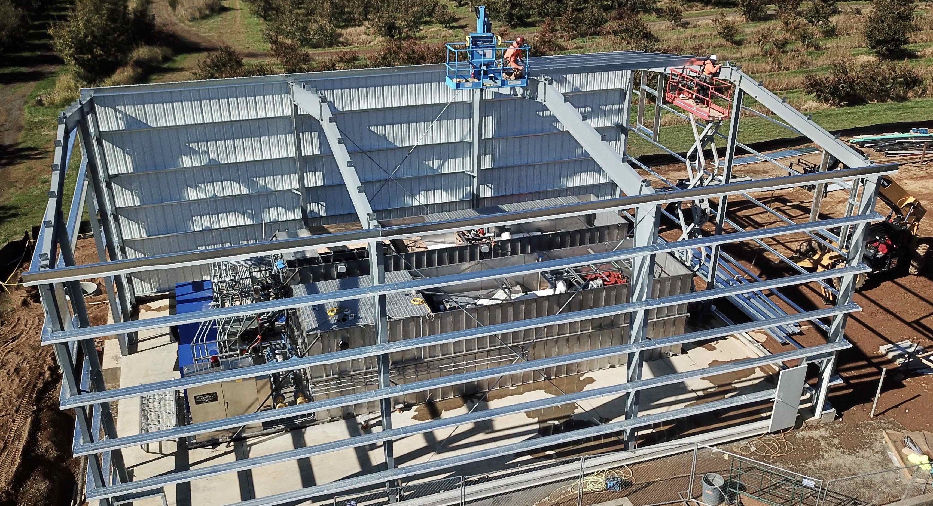
Membrane Bio-Reactor (MBR) Package Plant in a Barn-Like Building
(Actual size will depend on expansion capability)
Partial tank coverage to mitigate odors

Slide 12
Path Forward
The 60% design will be enhanced because it is based on available sites
The suitability of the preferred sites will be considered during and after the design and environmental activities
The site selection process will be repeated in the spring of 2022, once the basic design has been established
If possible, a tour of a similar operating package plant will be arranged in the near future for residents in the LOCSD and neighbors of potential sites

Slide 13
Backup Slides

Slide 14
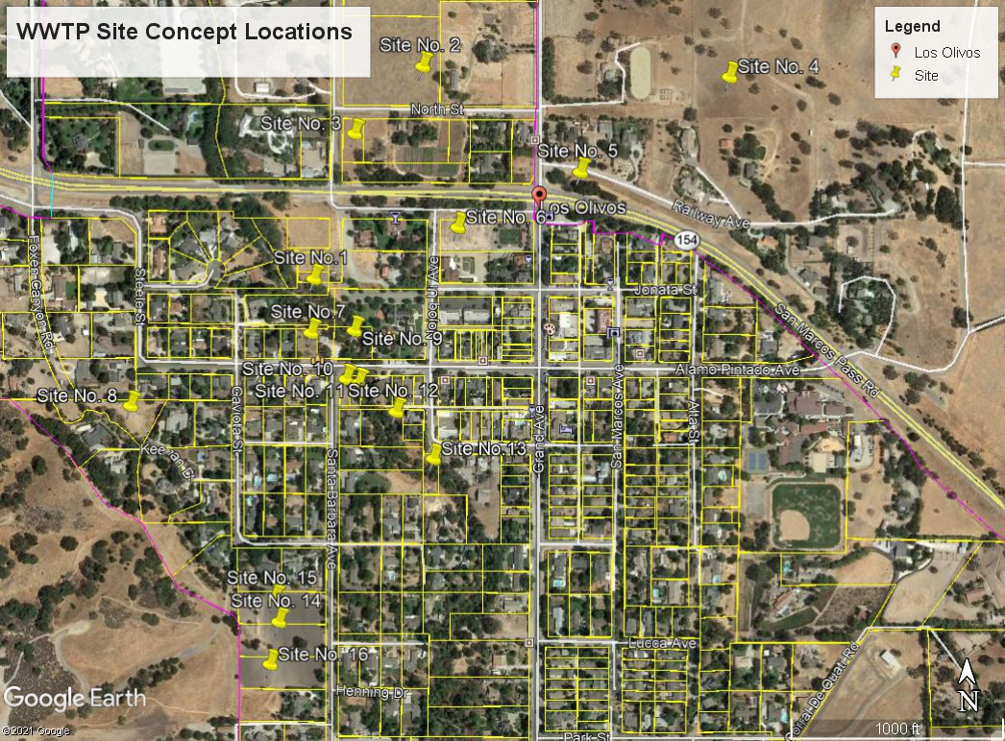
Sites Considered by UPC

