Slide 1

Los Olivos
Community
Services District
Tom Fayram, President
Guy Savage, General Manager
October 5, 2023

Slide 2
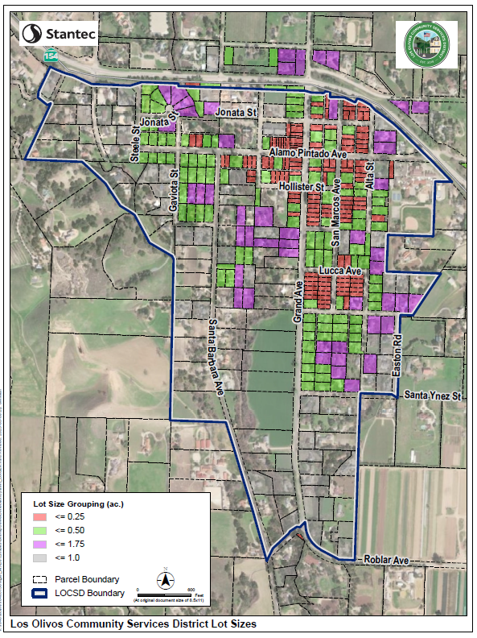
THE DISTRICT
376 Parcels
~40 Commercial
~336 Residential
Annual Budget
(FY 2023-24) $227,650

Slide 3
Los Olivos
Special Problems Area
1974 –
Special Problems
Area designation
2003 – County Septic to Sewer Study
2010 – Los Olivos WWMP
2013 – Draft Eng. Report ($11.2M)
2021 - 30% Design
Gravity / MBR $47.8M
2022 – 2 Monitoring Wells
2016 – Prelim Eng. Report ($20.9M)
2018 – LOCSD formed
Today
Notes:
Lots of technical studies and documents produced to further options and approaches
30% design
Monitoring plan
Basis of Design
Rubric

Slide 4
Community Input for
Successful Prop 218
Focus on (prioritized order):
  Cost (Construction and O&M)
  Ownership (District / Individual)
  Plant Location (Siting)
  No Growth Inducement
  Odors
  Viewshed Impacts
Underlying assumption that solution meets regulatory requirements and fixes groundwater issues

Slide 5
30% Design Documents
Gravity fed collection + MBR treatment Option
 | North Option | South Option
Zone 1 | $30,300,000 | $28,700,000
Zone 2 | $ 1,700,000 | $ 1,700,000
Zone 3 | $15,800,000 | $15,800,000
Total | $47,800,000 | $46,200,000
*Does not include laterals from homes, septic system removal
$125,000 per parcel,
PLUS: laterals, removal of existing septic system, effluent disposal
Notes:
2013 AECOM Preliminary Engineering Report put the total cost at $11.2M (23%) of latest estimate or $29,200 per parcel. Latest estimates over 4x as high.
2016 Update to PER put costs at $20.9M or $54,500 per parcel, still less than ½ of current estimates.

Slide 6
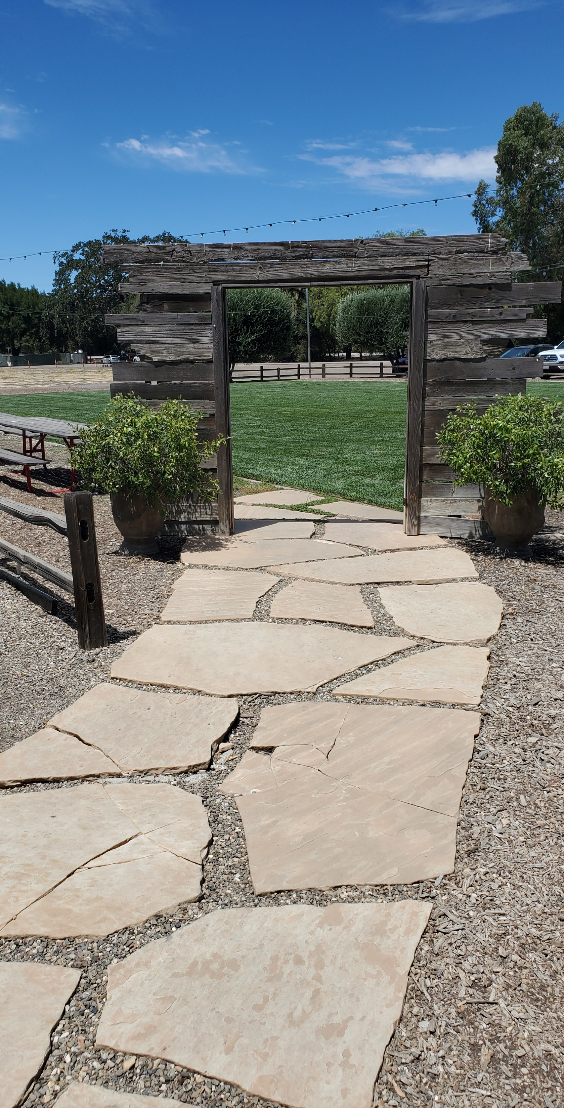
What are we doing now?
Focus on collection
  Gravity
  Effluent Sewer (STEP)
  Advanced On-site
Additional monitoring wells

Slide 7
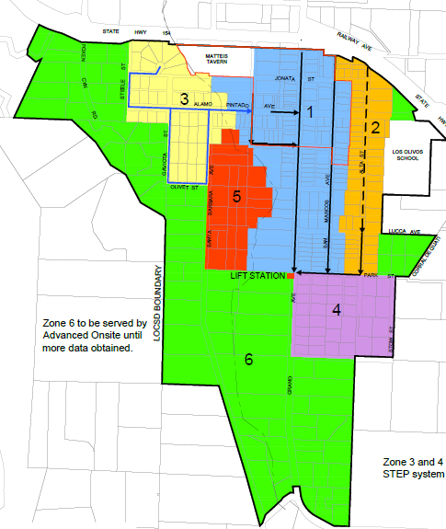


Hybrid approach
7
Eight zones
Three technologies
Number of zones within each implementation phase will depend on grant funding
Use of individual advanced onsite systems in zone 6 is limited
Technology for Los Olivos School and the Inn at Mattei’s Tavern to be determined
8
Gravity
Zones 1, 2
Effluent
Zones 3, 4, 5
Advanced On-site
Zone 6

Slide 8
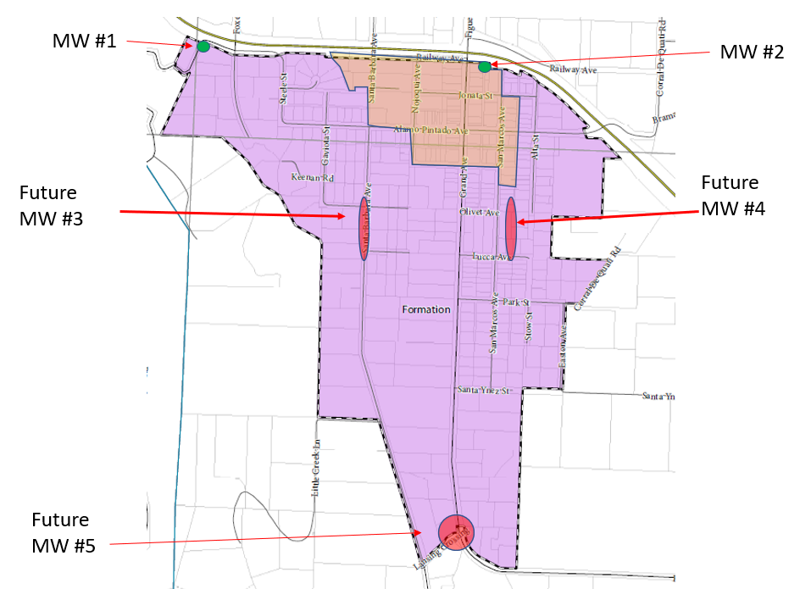
Monitoring Wells
MW #1
2.6/10
MW #1
10/10
Future
MW #3
Future
MW #4
Grant Application
  $121,445
  3 new wells
  5 well tests
Future
MW #5

Slide 9
What’s Next?
Technical evaluation and related cost
  Collection (120 day contract)
  Treatment (concurrent with collection, Solvang?)
Additional Public Workshops and Outreach
Final Project Description
Pursue Grants
Environmental
Hold Benefit Assessment Vote

Slide 10
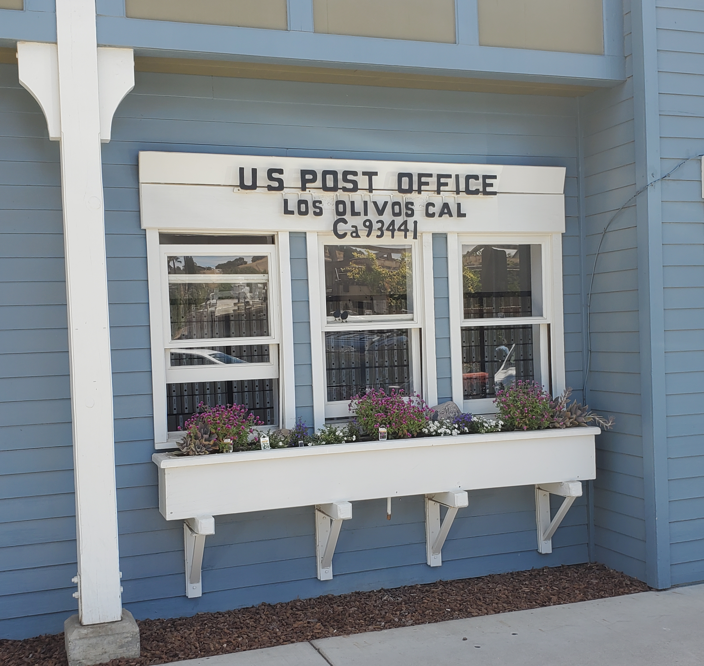
Questions and Discussion
Visit us at:
  www.losolivoscsd.com
Subscribe to our updates:
  www.losolivoscsd.com/subscribe
Contact us:
LosOlivosCSD@gmail.com
(805) 500-4098

Slide 11
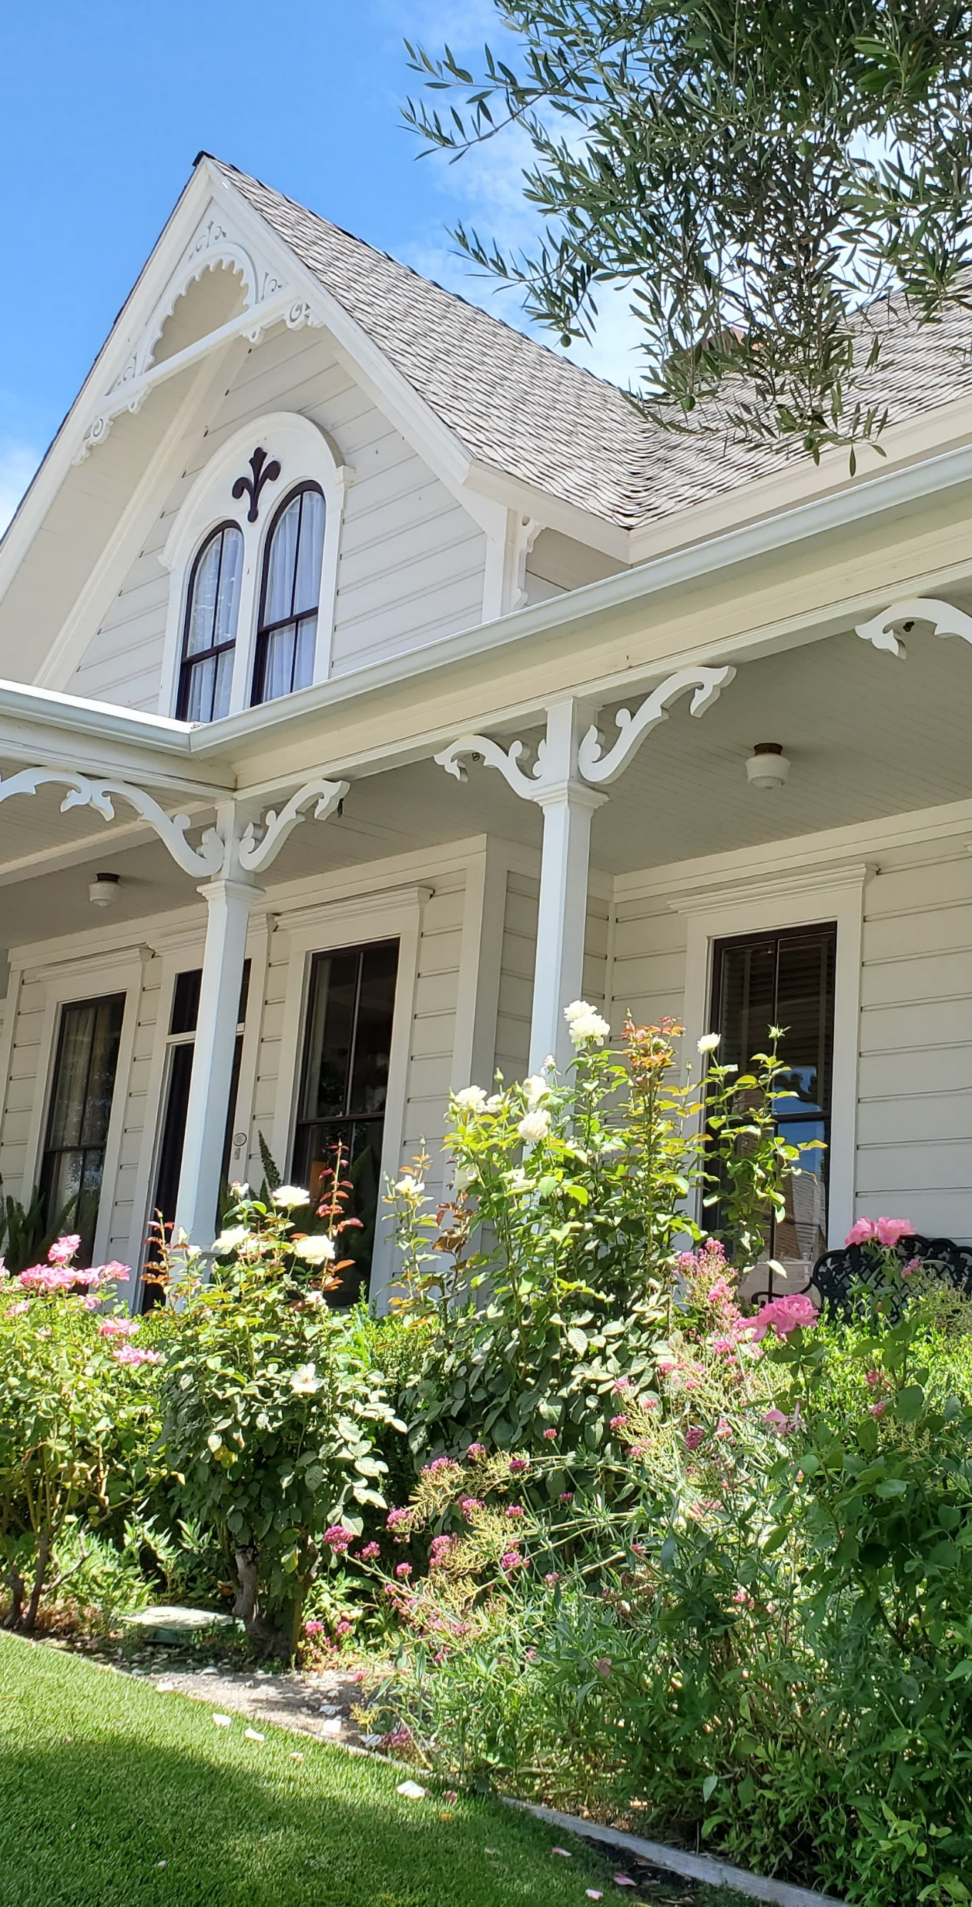
Los Olivos
Community Services District Board
Tom Fayram, President (2024)
Nina Stormo* (2024)
Julie Kennedy (2026)
Lisa Palmer (2026)
Greg Parks (2026)
*Appointed 9/2023

